Slide 1

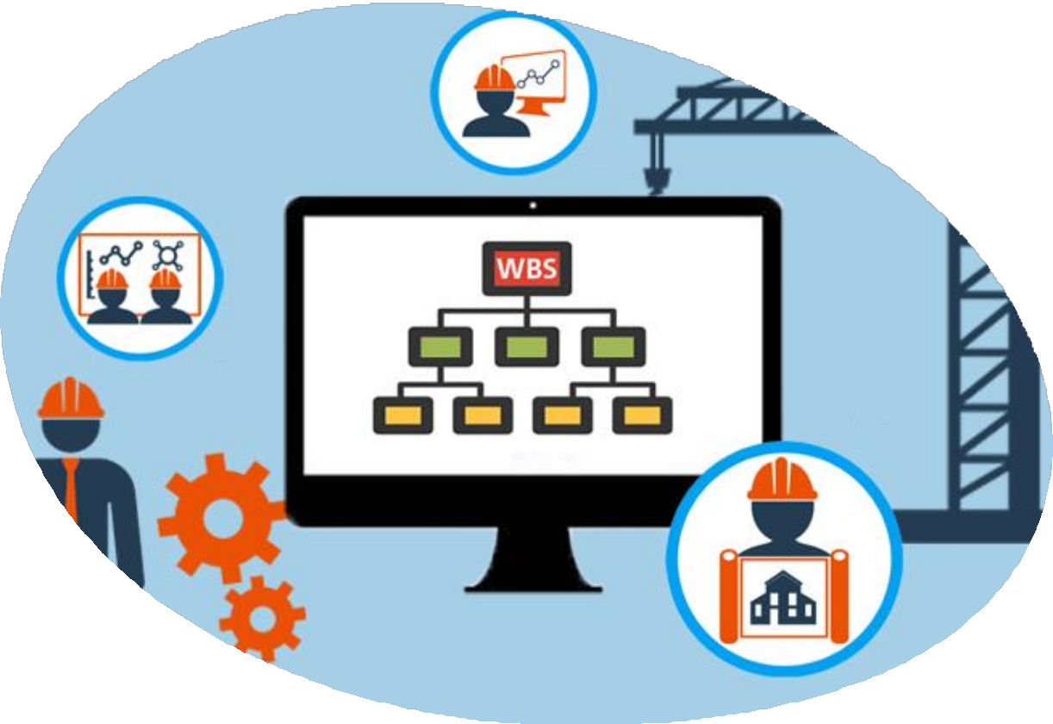
Project Management
Work Breakdown Structure

Slide 2
What is WBS (Work Breakdown Structure)?
As per PMBOK the work breakdown structure is:
“A deliverable-oriented hierarchical decomposition of the work to be executed by the project team to accomplish the project objectives and create the required deliverables”.
“A Work Breakdown Structure (WBS) is a hierarchical structure of things that the project will make or outcomes that it will deliver”

Slide 3
What is WBS (Work Breakdown Structure)?
In simple words:
“A work breakdown structure defines all the things a project needs to accomplish, organized into multiple levels, and displayed graphically.”
Essentially, the WBS defines the “what” of the project. Everything you need to accomplish in the project is displayed in a single, easy-to- understand chart. The purpose of this chart is to break down complex activities into smaller, more management constituents.

Slide 4
WBS example for an Aircraft System
Developing an aircraft system is obviously a very complex endeavor. You need an aircraft (which itself is an extremely complex undertaking), a system to train staff and pilots, a way to manage infrastructure, etc.
Its WBS breaks down all these complex activities into smaller, more management constituent parts.
Thus, there might have one group responsible for building an aircraft. Within this group, there might have one team focused on building the airframe, another on creating a propulsion system, and so on.
It’s common to have three levels of decomposition in the WBS. One might have a fourth and even a fifth level in case of extremely complex projects. For most projects, however, three levels will be sufficient.

Slide 5
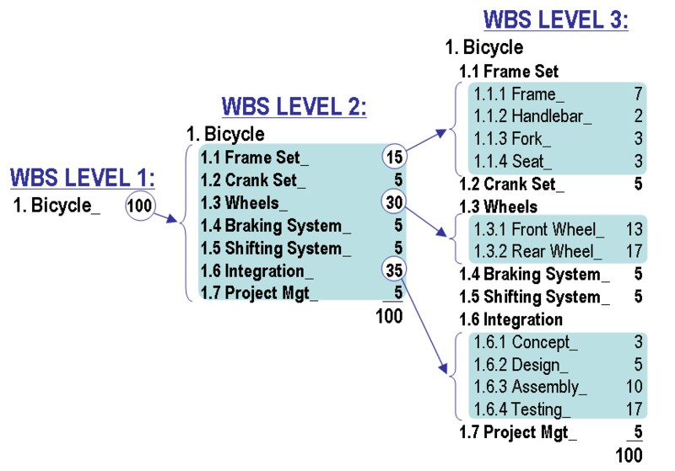
WBS example for making a Bicycle

Slide 6
The numbers next to each item indicate the number of hours or resources required to
complete the work. The sum of all these must be 100 at each level.
This is called “100% rule” - that the sum of the work at each “child” level must be 100% of the work at the “parent” level.
The WBS doesn’t describe any actions. Instead, every item is a noun describing an end product - a bicycle seat, fork, handlebar, etc.
This is one of the fundamental features of a WBS: it describes deliverables, not the activities necessary to get there. Every item in the WBS must correspond to an end product (real or virtual). If there are any verbs in WBS, then one is doing something wrong.
For example, if one is creating a work breakdown structure for manufacturing a car, he/she’ll include items such as “car body” (a deliverable), not “welding steel” (an activity).

Slide 7
Relevant Definitions
Work: work refers to “work products or deliverables that are the result of effort and not the effort itself”. That is, “work” defines the end result of any activity. The work remains constant even though the amount of effort needed to get there might inflate/deflate.
Deliverable: A deliverable is “any unique and verifiable product, result, or capability to perform a service that is required to be produced to complete a process phase, or project”. Deliverables will vary from project to project and client to client.
Work package: According to PERT (which developed the WBS), a work package is “the work required to complete a specific job or process, such as a report, a design, a documentation requirement or portion thereof, a piece of hardware, or a services., a simpler definition: “a work package is a deliverable at the lowest level of the WBS.”
For example, if one is making a bicycle, a “bike seat” might be one of his deliverables. All the work required to create the seat - cutting leather, shaping foam, creating metal frame, etc. - would be part of the work package.

Slide 8
Characteristics of the Work Breakdown Structure
Not every breakdown of project deliverables can be classified as a WBS. For it to be called a work breakdown structure, it must have certain characteristics:
Hierarchy: The WBS is hierarchical in nature. Each “child” level exists in a strict hierarchical relationship with the parent level. The sum of all the child elements should give you the parent element.
100% rule: Every level of decomposition must make up 100% of the parent level. It should also have at least two child elements.
Mutually exclusive: All elements at a particular level in a WBS must be mutually exclusive. There must be no overlap in either their deliverables or their work. This is meant to reduce miscommunication and duplicate work.
Outcome-focused: The WBS must focus on the result of work, i.e. deliverables, rather than the activities necessary to get there. Every element should be described via nouns, not verbs. This is a big source of confusion for beginners to WBS.

Slide 9
Work Breakdown Structure (WBS) Examples
The best way to understand how work breakdown structures work is by looking at different WBS examples. Seeing how complex projects are actually broken down can help you do the same in your projects.
While work breakdown structures are technically supposed to focus on deliverables, not activities (i.e. nouns, not verbs), plenty of project managers skip this rule in actual projects. Which is why one’ll see WBS examples where top-level “deliverables” actually describe activities.
This isn’t ideal, but keep in mind that people use work breakdown structure for all sorts of things, even outside of project management - writing a book, planning a vacation, etc. If one is using it casually, he/she don’t really have to follow all the hard rules.
On that note, let’s look at some work breakdown structure examples.

Slide 10
A Casual WBS Example
The convenient format of the WBS means that one can use it for any number of purposes, including managing casual projects.
In such cases, don’t really have to follow the formal guidelines of a work breakdown structure. Rather, the goal should be to create natural categories and sub-categories. The only restriction, They should all add up to 100% of the work to be done.

Slide 11
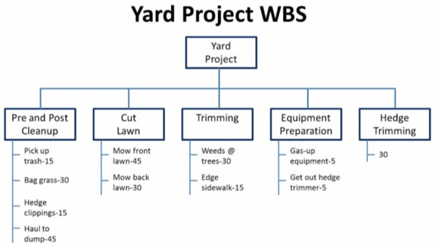
A Casual WBS Example (Cont)

Slide 12
A Casual WBS Example (Cont)
Note that the WBS lists activities (“cut lawn”) instead of deliverables. This wouldn’t pass muster in a formal work breakdown structure, but if one is using something internally, it doesn’t really matter as long as each level makes sense.

Slide 13
Computer Program WBS Example
WBS example, one can see one of the biggest mistakes people make when creating the WBS: mistaking activities for deliverables.
As one can see, the third-level in the WBS identifies activities such as “develop business case” or “perform primary planning”.
This is extra within the context of a WBS. If one remove the verb from each of these WBS levels, he/she’d get a deliverable (i.e. a noun), not an activity. That is, one don’t need “develop business case” - just “business case” is enough.
When to create work breakdown structures, there is need to remove verbs from each WBS level. One is, after all, describing things that need to be delivered, not the tasks necessary to deliver them.

Slide 14
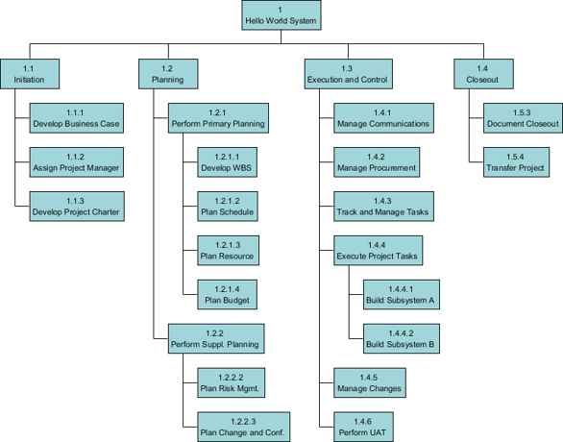

Slide 15
WBS vs Project Schedule vs Project Plan
Common source of confusion for beginners is the difference between the work breakdown
structure, project schedule, and project plan.
While these three things often describe the same thing - what is to be achieved in the project - they vary greatly in scope and details.
Work breakdown structure describes the deliverables needed to complete the project, i.e. the “what” of the project. It doesn’t include timelines or resources. The goal of the WBS is to give the project team a hyper-focused idea of what they need to achieve.

Slide 16
WBS vs Project Schedule vs Project Plan
Project schedule describes the project’s deliverables as well as their deadlines and resource
requirements. Think of it as the “what”, “when”, and “who” of the project.
Project plan is an expansive document covering virtually every aspect of the project and its management. It includes details on how the project will be executed, managed, and
controlled. It usually has several constituent plans governing communications, risk management, change management, etc.
In terms of the level of detail, you can think of the project plan as the broadest, followed by the project schedule, and finally, the work breakdown structure.

Slide 17
Benefits of a WBS
The WBS is a laser-focused breakdown of all the key deliverables needed to make the project successful. Creating one offers several advantages, such as:
Project schedule: The WBS is the foundation of the project schedule and budget. Once you know all the deliverables required to complete the project, as well as their hierarchical relationships, it will be much easier to assign resources and set deadlines.
Accountability: Since all elements in a WBS are mutually exclusive, it helps create accountability. A team assigned to a single work package is wholly accountable for its completion. This reduces overlaps in responsibility.

Slide 18
Benefits of a WBS (Cont)
Commitment: The WBS gives teams a very high-level overview of their responsibilities. Since each team is responsible for a specific component at a time, it helps make them more committed to completing their assigned tasks.
Reduces ambiguities: The process of developing the WBS involves the project manager, project team, and all relevant stakeholders. This encourages dialog and helps everyone involved flesh out their responsibilities. Thus, everyone has less ambiguity and a better idea of what they're supposed to do.
Creating a WBS is the first step in developing a comprehensive project schedule. It can be of massive help in getting everyone to understand the project’s scope and deliverables at different levels.

Slide 19
WBS in Project Management
The work breakdown structure springs from the project charter. Ideally, the high- level deliverables in the WBS should match, word for word, the goals and deliverables listed in the project scope statement.
Consequently, the WBS is one of the first documents created in the project management lifecycle. One’ll create it before he/she create the Gantt chart or the project plan.
Which is to say, the WBS is often the first deliverable in a project.
While the stated benefit of a WBS is in helping one keep track of deliverables and managing project scope, it has another key use in project management: creating the project schedule.

Slide 20
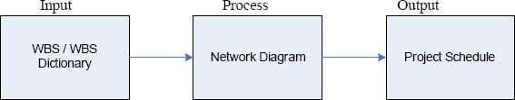
WBS in Project Management (Cont)
Understanding the deliverables included in a WBS and mapping their relationships is crucial for charting a project schedule. Within this process, one first creates a WBS dictionary (i.e. list of deliverables), turns these deliverables into a map of relationships (i.e. a network diagram) and uses it to create the schedule.
One can also use the map of deliverables (and the relationships between them) in a WBS to figure out the resources to be used in their creation. This is
called a Resource Breakdown Structure (RBS).

Slide 21
WBS in Project Management (Cont)
A resource breakdown structure consists of both the material and human resources required to complete a deliverable. For example, if you’re creating a chair as part of a larger house remodeling project, you’ll need:
A carpenter
Raw materials such as wood, polish, nails, glue, etc.
Tools such as hammers, saws, drills, etc.

Slide 22
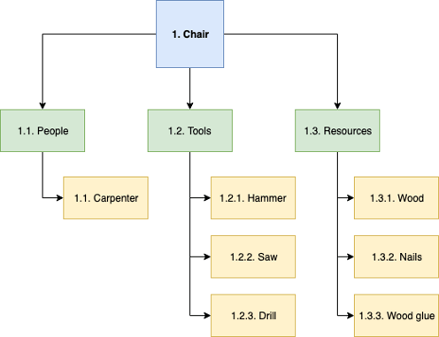
WBS in Project Management (Cont)
One can represent these resources as under:
Once one understand how resources will be used to create each deliverable, he/she can also improve his/her project scheduling - one of the many ways a work breakdown structure finds use in project management.

Slide 23
Creating WBS
The output of the WBS development process might seem simple: a short
document with a list of deliverables. To create it, however, one needs a thorough
understanding of the project’s scope, his/her team’s capabilities, and his/her
stakeholders’ requirements.
Process for creating a WBS from scratch consists of following steps:
Understand the Project’s Scope
Determine Major Deliverables
Determine Work Packages
Create a WBS Dictionary
Use the Right WBS Format

Slide 24
Steps in Creating WBS
1. Understand the Project’s Scope
WBS is one of the key documents created at the end of the ‘Planning’ phase.
Before one can create it, however, one needs a thorough understanding of the project’s scope and objectives.
Mainly, one needs two things:
Project scope statement to understand the project’s scope in detail.
Project scope management plan to understand how to deal with changes to the project’s scope (which will
affect your deliverables).
One’ll want to refer to his/her project charter to develop the scope statement and scope management plan.
The output of the entire WBS development process is as follows:
Work breakdown structure
WBS dictionary
Scope baseline

Slide 25
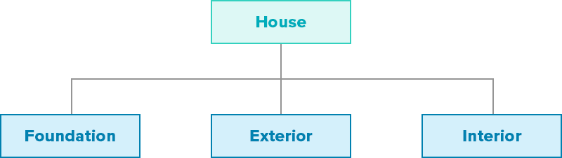
Steps in Creating WBS
2. Determine Major Deliverables
After having understanding of the project scope, start the WBS development process by figuring out the key deliverables.
For example, if one goal is to “build a house”, he/she might have the following three broad
deliverables at Level 2:
There are two heuristics you can follow for determining major deliverables at the 2nd level:
Each deliverable must be essential to the success of the project. For example, you can’t build a house
without a foundation, exterior, or interior.
Each deliverable should be the responsibility of an independent team. In the above example, the team
responsible for laying the foundation won’t be the same as the team building the interiors.

Slide 26
Steps in Creating WBS
3. Determine Work Packages
A work package is a deliverable at the lowest level of a WBS.
In a typical 3-level WBS, determining work packages would be the next step after identifying major deliverables.
This is one of the most important parts of the WBS development process and one that will require extensive input from project team and stakeholders.
Goal is to pick a major deliverable, then identify all the work necessary to complete it. This work package must be:
Independent: The work package must be mutually exclusive and have no dependence on other ongoing elements.
Definable: The work package should have a definite beginning and end, and should be understood by all project participants.
Estimable: You should be able to estimate the work package's duration and resource requirements.
Manageable: The package must represent a "meaningful unit of work", i.e. it must accomplish something concrete, and can be assigned to an individual or team. It should also be measurable.
Integratable: The package must integrate with other elements to create the parent level.
Adaptable: Ideally, the package must be able to accommodate changes in scope as per the project's requirements.

Slide 27
Steps in Creating WBS
3. Determine Work Packages (Cont)
In case the work can’t meet the above requirements, you can decompose the WBS into another level. There are a few heuristics you can follow for determining work packages:
8/80 rule: A common rule of the thumb is that each work package must be no longer than 80 hours and no less than 8 hours in total length. If it is longer, decompose it further. If it is shorter, think of going up by one level.
Reporting period: Another common rule is to limit each work package to a single reporting period. If it takes longer than one reporting period (monthly, weekly, etc.), to accomplish, decompose it further.
Use nouns: You should be able to describe each work package with a noun or an adjective. To break it down further, you’ll need to use verbs. For example, “bike seat” is a noun describing a work package. If you break it down further, you’ll need to use verbs like “cut foam”, “stitch leather”, etc.

Slide 28
Steps in Creating WBS
4. Create a WBS Dictionary
The WBS dictionary is a document that outlines the definition and scope of each element contained in the WBS. It is a supporting document meant to help incoming project teams understand each work package better.
You don't necessarily need a WBS dictionary, especially if the project is simple or limited in scope. For complex projects with a lot of churn, however, the dictionary can greatly improve clarity.
Further, the WBS dictionary takes you one step closer to creating the project schedule. You can often
transplant details from this dictionary straight to your project scheduling tool.
Here are a few details you can include for each item in the WBS dictionary:
Work package ID (see the ID convention below)
Work package name
Work package description
Assigned to (individual or team name)
Department
Date of assignment
Due date
Estimated cost

Slide 29
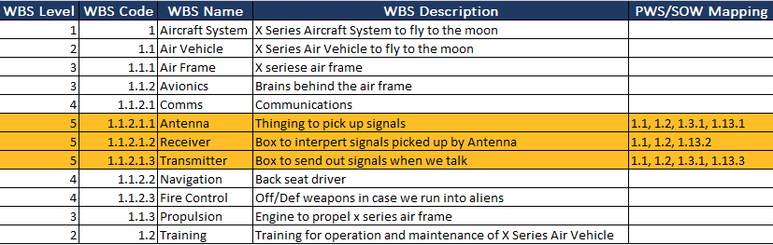
Steps in Creating WBS
4. Create a WBS Dictionary (Cont)
The level of detail one want to include is entirely up to him/her.
Here's an example of a more simplified WBS dictionary with element ID, name, and description:
A WBS dictionary helps project team members understand each element

Slide 30
Steps in Creating WBS
5. Use the Right WBS Format
Once one has all the work packages and WBS dictionary, it’s time to create the WBS.
There are several WBS formats one can follow. The simplest way to do this is to create text-based hierarchical groupings. By convention, one use numbers and decimal points to indicate the level of the element.
For example, the number 1.1.1.3 means that you’re referencing the 3rd element of the 4th level of the WBS.

Slide 31
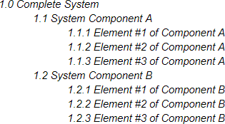
Steps in Creating WBS
5. Use the Right WBS Format (Cont)
Thus, one might have a text-based WBS as under:

Slide 32
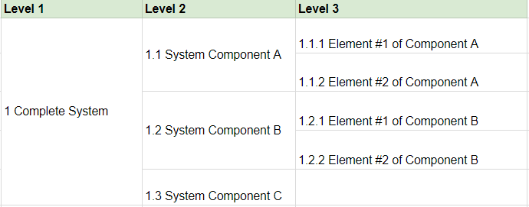
Steps in Creating WBS
5. Use the Right WBS Format (Cont)
Alternatively, one might use a more visual tabular structure as under:

Slide 33
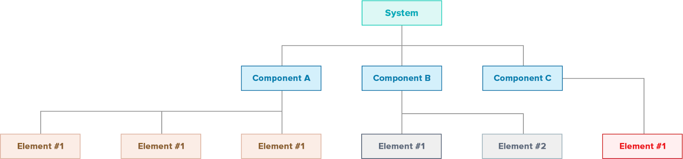
Steps in Creating WBS
5. Use the Right WBS Format (Cont)
Another option is to create a flowchart:

Slide 34
Key WBS Best Practices
The work breakdown structure is the foundation of project schedule, which, in turn, is the foundation of the entire project.
Following a few best practices in the WBS creation phase can greatly improve the accuracy of project schedule. A clear breakdown of key deliverables will help to estimate and assign resources better.
Here are some key best practices one should follow when creating a work breakdown structure:
Use Nouns, Not Verbs
Follow the 100% Rule Closely
Keep All Elements Mutually Exclusive
Mind the Level of Detail
Use a Project Management Software

Slide 35
Key WBS Best Practices
1. Use Nouns, Not Verbs
The purpose of a WBS is to track deliverables, not activities. The "what" of the work matters, not the "how" of getting there.
One way to achieve this goal is to use nouns when adding elements to the WBS. That is, every element in the WBS should be either a noun or an adjective.
Think of "House foundation" instead of "Removing earth to create the foundation",
or "Communication plan document" instead of "Gathering requirements for
communication plan".
The goal of this "nouns, not verbs" exercise is to force one to keep his/her elements broad in scope. Activities usually describe the final level in any work package. WBS should focus on one level above that.

Slide 36
Key WBS Best Practices
2. Follow the 100% Rule Closely
A work breakdown structure is meant to be exhaustive. There should be no deliverable outside of the WBS.
This is why it is crucial that one should follow the 100% rule. Every level should be
everything one needs to deliver. Anything beyond that should be scrapped.
This helps to spot gaps and redundancies. It also ensures that every project component is complete and nothing is left behind.

Slide 37
Key WBS Best Practices
3. Keep All Elements Mutually Exclusive
The other cardinal rule of work breakdown structures - besides the 100% rule - is "mutual exclusivity". Every element should be independent. One shouldn't need any input from any other element to complete it. If one do, it's better to combine the two elements together and push the work package up a level.
For example, if one is making a bicycle, he/she can create a "handlebar"
independently of the "bicycle frame". Thus, it would be a separate work package.
In contrast, to create the "wheel spokes", one first needs to have the exact dimensions of the wheel rim. In such a case, it would be better to combine "wheel spokes" and "wheel rim" into a single work package.

Slide 38
Key WBS Best Practices
4. Mind the Level of Detail
A common mistake when creating work breakdown structures is to keep the level of detail either too broad (i.e. too few levels) or too narrow (i.e. too many levels).
Ideally, the decomposition should stop before one can use verbs to describe the element. For instance, if one is making a bicycle, "wheel rim" should be the final level since it describes a deliverable. If one decomposes further, he/she'll have activities related to the deliverable such as "buy steel", "shape steel", "make holes for wheel spokes", etc.
If this happens, one knows he/she has got too many levels.
Aim for between 3-5 levels. Any further than that and one is looking at a project that's likely too complex (and might be better as a program).

Slide 39
Key WBS Best Practices
5. Use a Project Management Software
One of the best tips about WBS is to “use a template”.
One might use a simple Word template, or one might use something offered by his/her flow chart tool. But if one wants the WBS to integrate with the rest of his/her project documents, the best source of templates is his/her project management software.
Most PM tools have built-in capabilities to create a work breakdown structure from scratch. One can simply specify his/her level of detail and add element data to create a WBS quickly.
The best part about using a PM tool is that one’s WBS data is available to him/her when he/she is creating project schedule.
If one follows these guidelines, he/she’ll have a highly effective work breakdown
structure that will help him/her in every phase of project planning.

Slide 40
Thanks

